Slide 1
Zooming to have Nspired Math Google Meetings Remotely
Weekly Wednesday Webinar Canadian Series
Wednesday, April 1, 2020
7:00 – 8:00 p.m.

Slide 2
Tom Steinke
Educational Technology Consultant – Canada
Texas Instruments – Education Technology Group
Ottawa, Ontario, Canada
tsteinke@ti.com
613-601-6535

Slide 3
Chris Atkinson
Math Department Head
Sacred Heart High School
Stittsville, Ontario, Canada
chris.atkinson@ocsb.ca

Slide 4
Session at a glance …
Chris will share how he schedules and uses Zoom and Google Hangouts Meet to maintain a human connection with his math department members and students as he supports them transition to remote learning
Tom and Chris will then share how they use the TI-Nspire™ CAS App for iPad® to help introduce modelling linear systems from Olympic data and modelling quadratics using photos

Slide 5
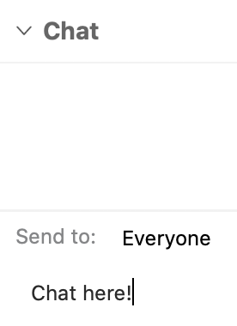
We want to hear from you …
During the Webinar, we will monitor the Chat and try to be responsive to ideas and questions that surface
In addition, we will get feedback from you to inform how we modify and adapt our Webinar focii

Slide 6
I teach…

Slide 7
I teach kids …

Slide 8
Maintaining human connections …
Modeling for math department
Scheduling Zoom and Google Hangouts Meet
How has it gone so far

Slide 11
Check in on the Chat …

Slide 12
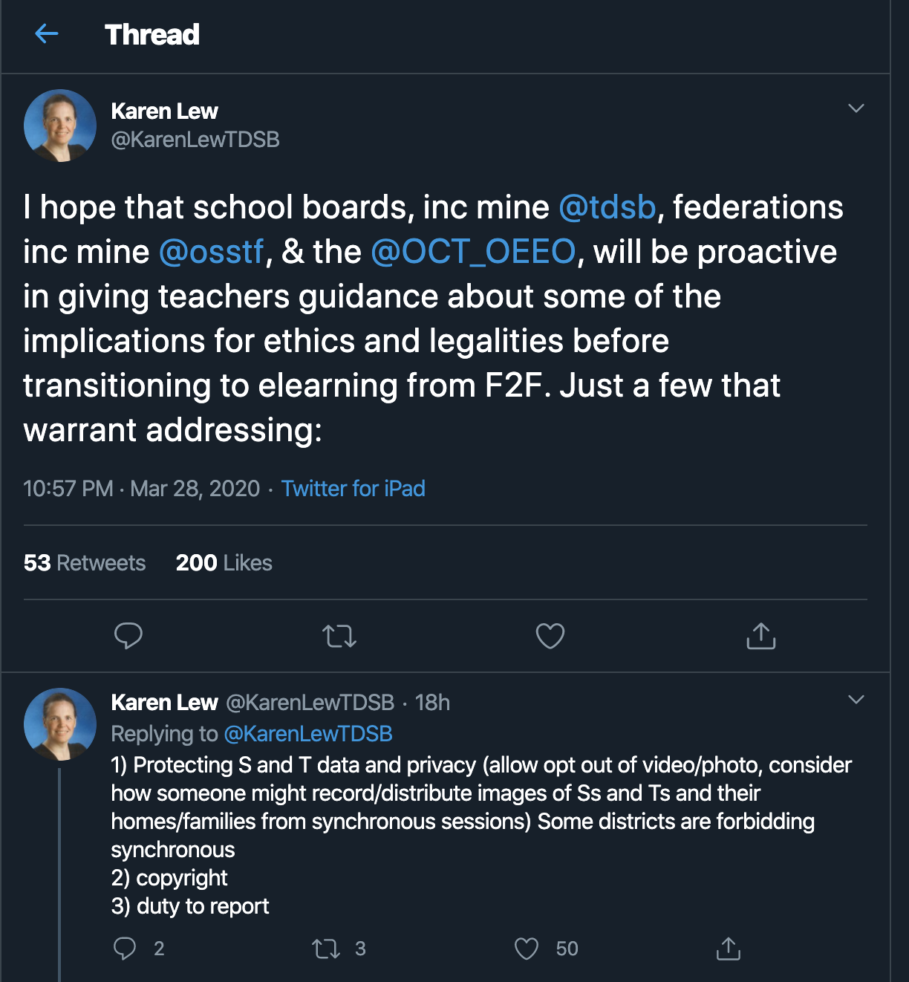

Slide 13
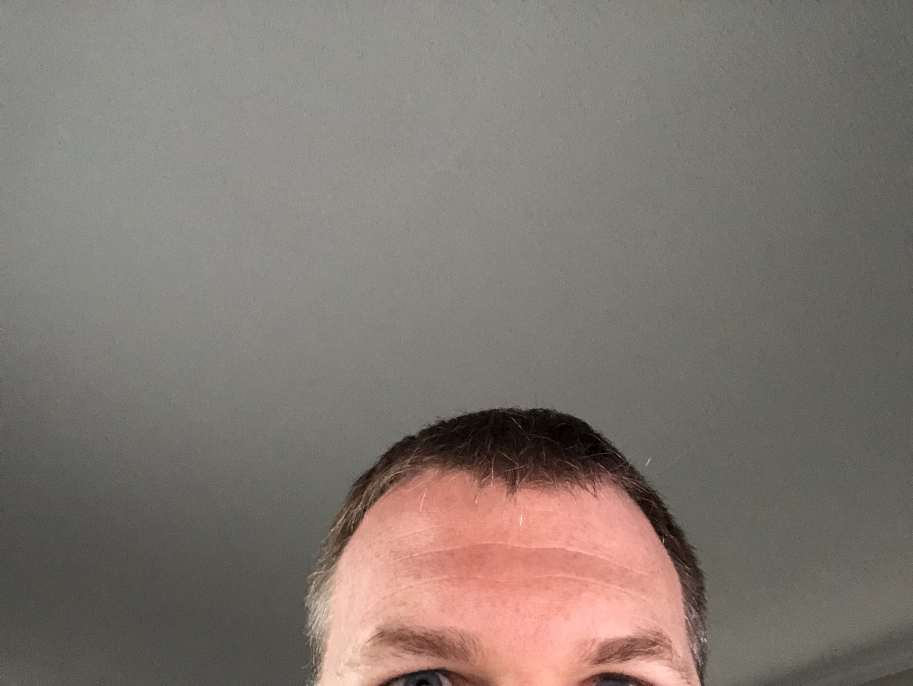
Plan for …
More time than you thought
Less content than you would have wanted
Slower adoption than you expected

Slide 14
education.ti.com

Slide 15
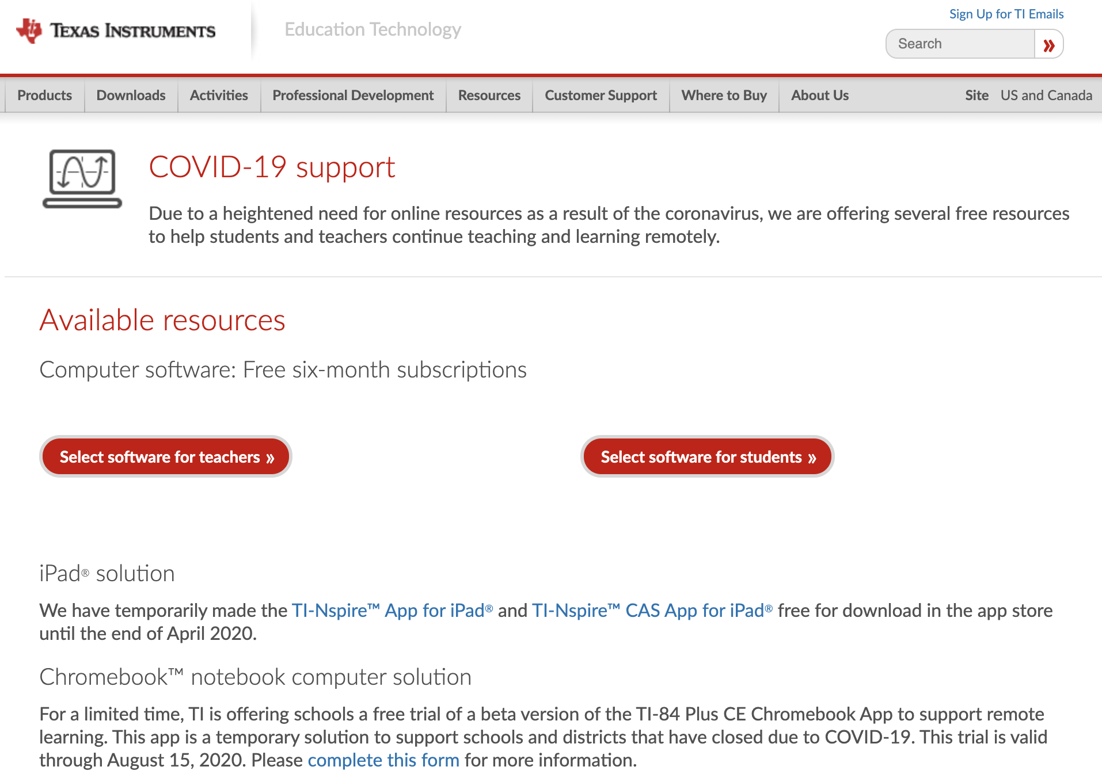
Covid-19 Supports

Slide 16
TI has temporarily made the TI-Nspire™ CAS App for iPad® free for download in the app store until the end of April 2020

Slide 18
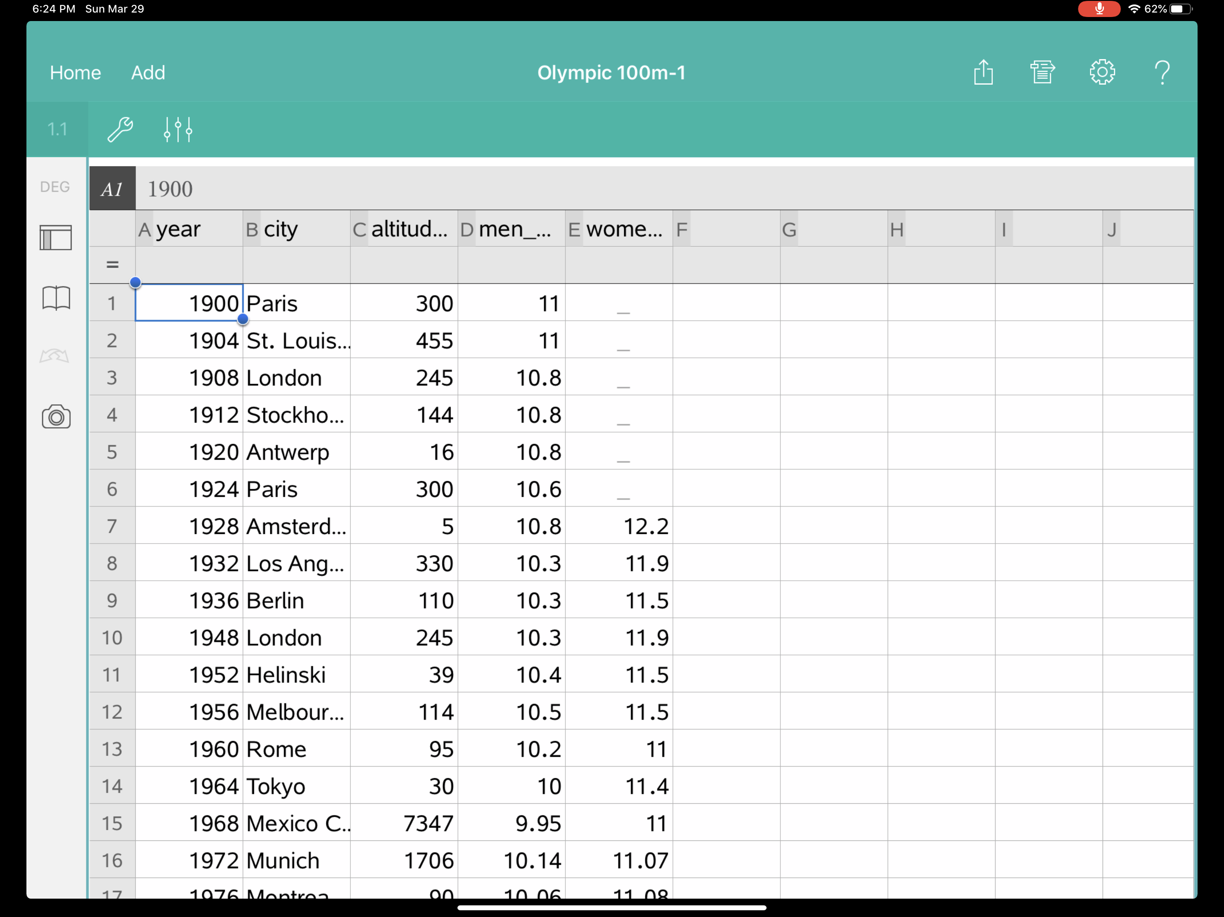
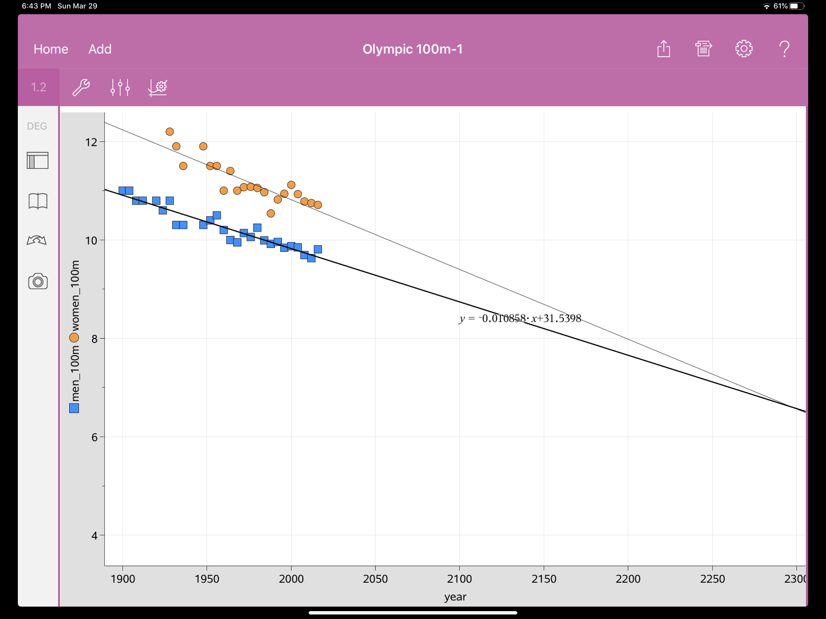
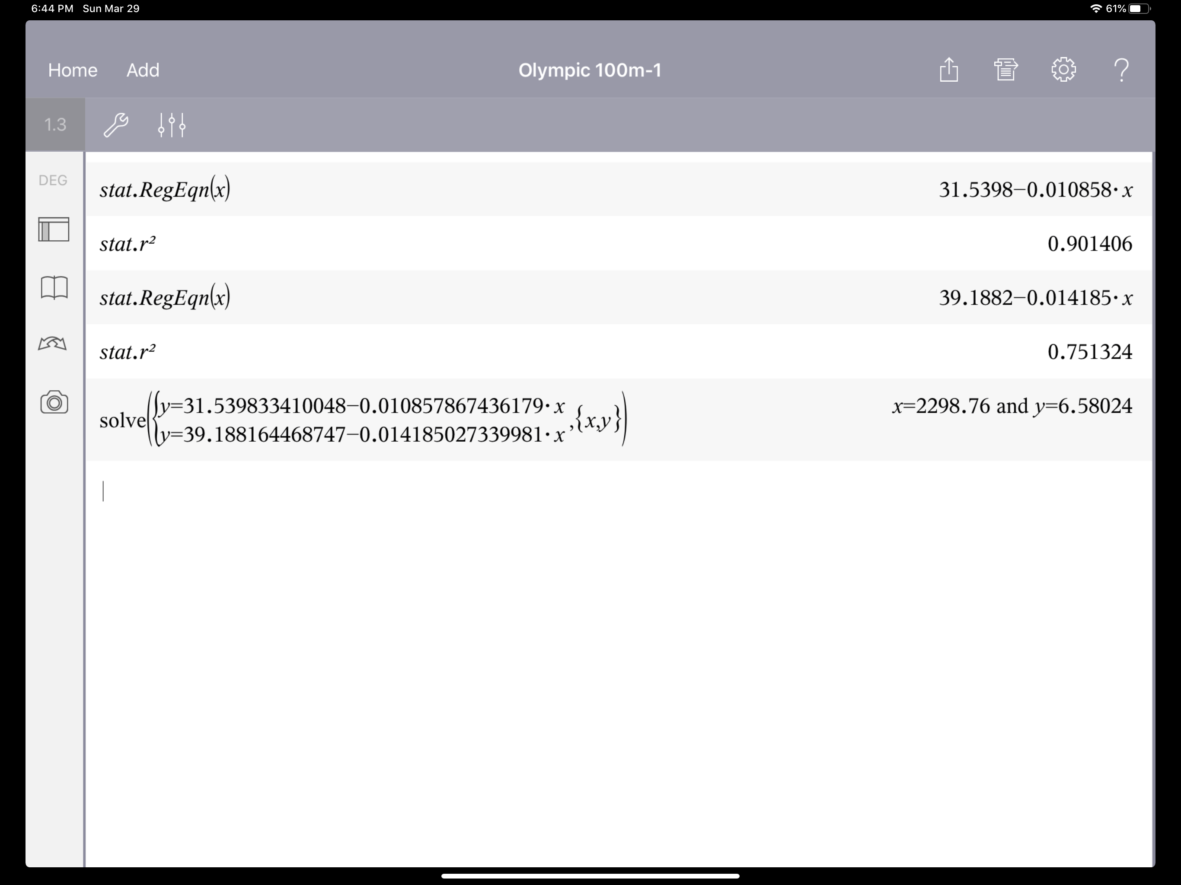
Olympic Linear Systems

Slide 19
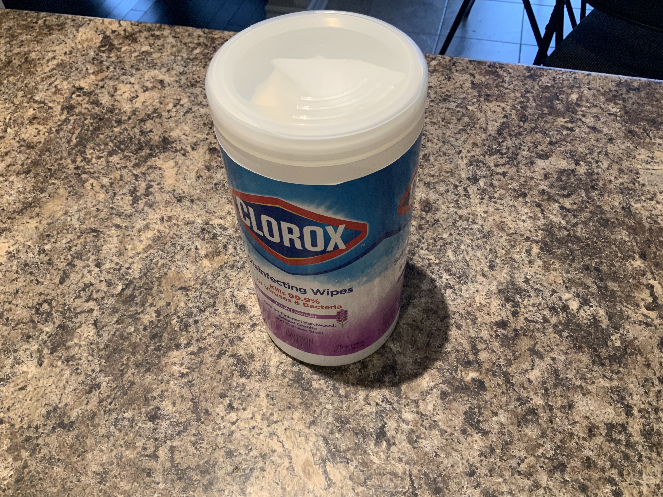
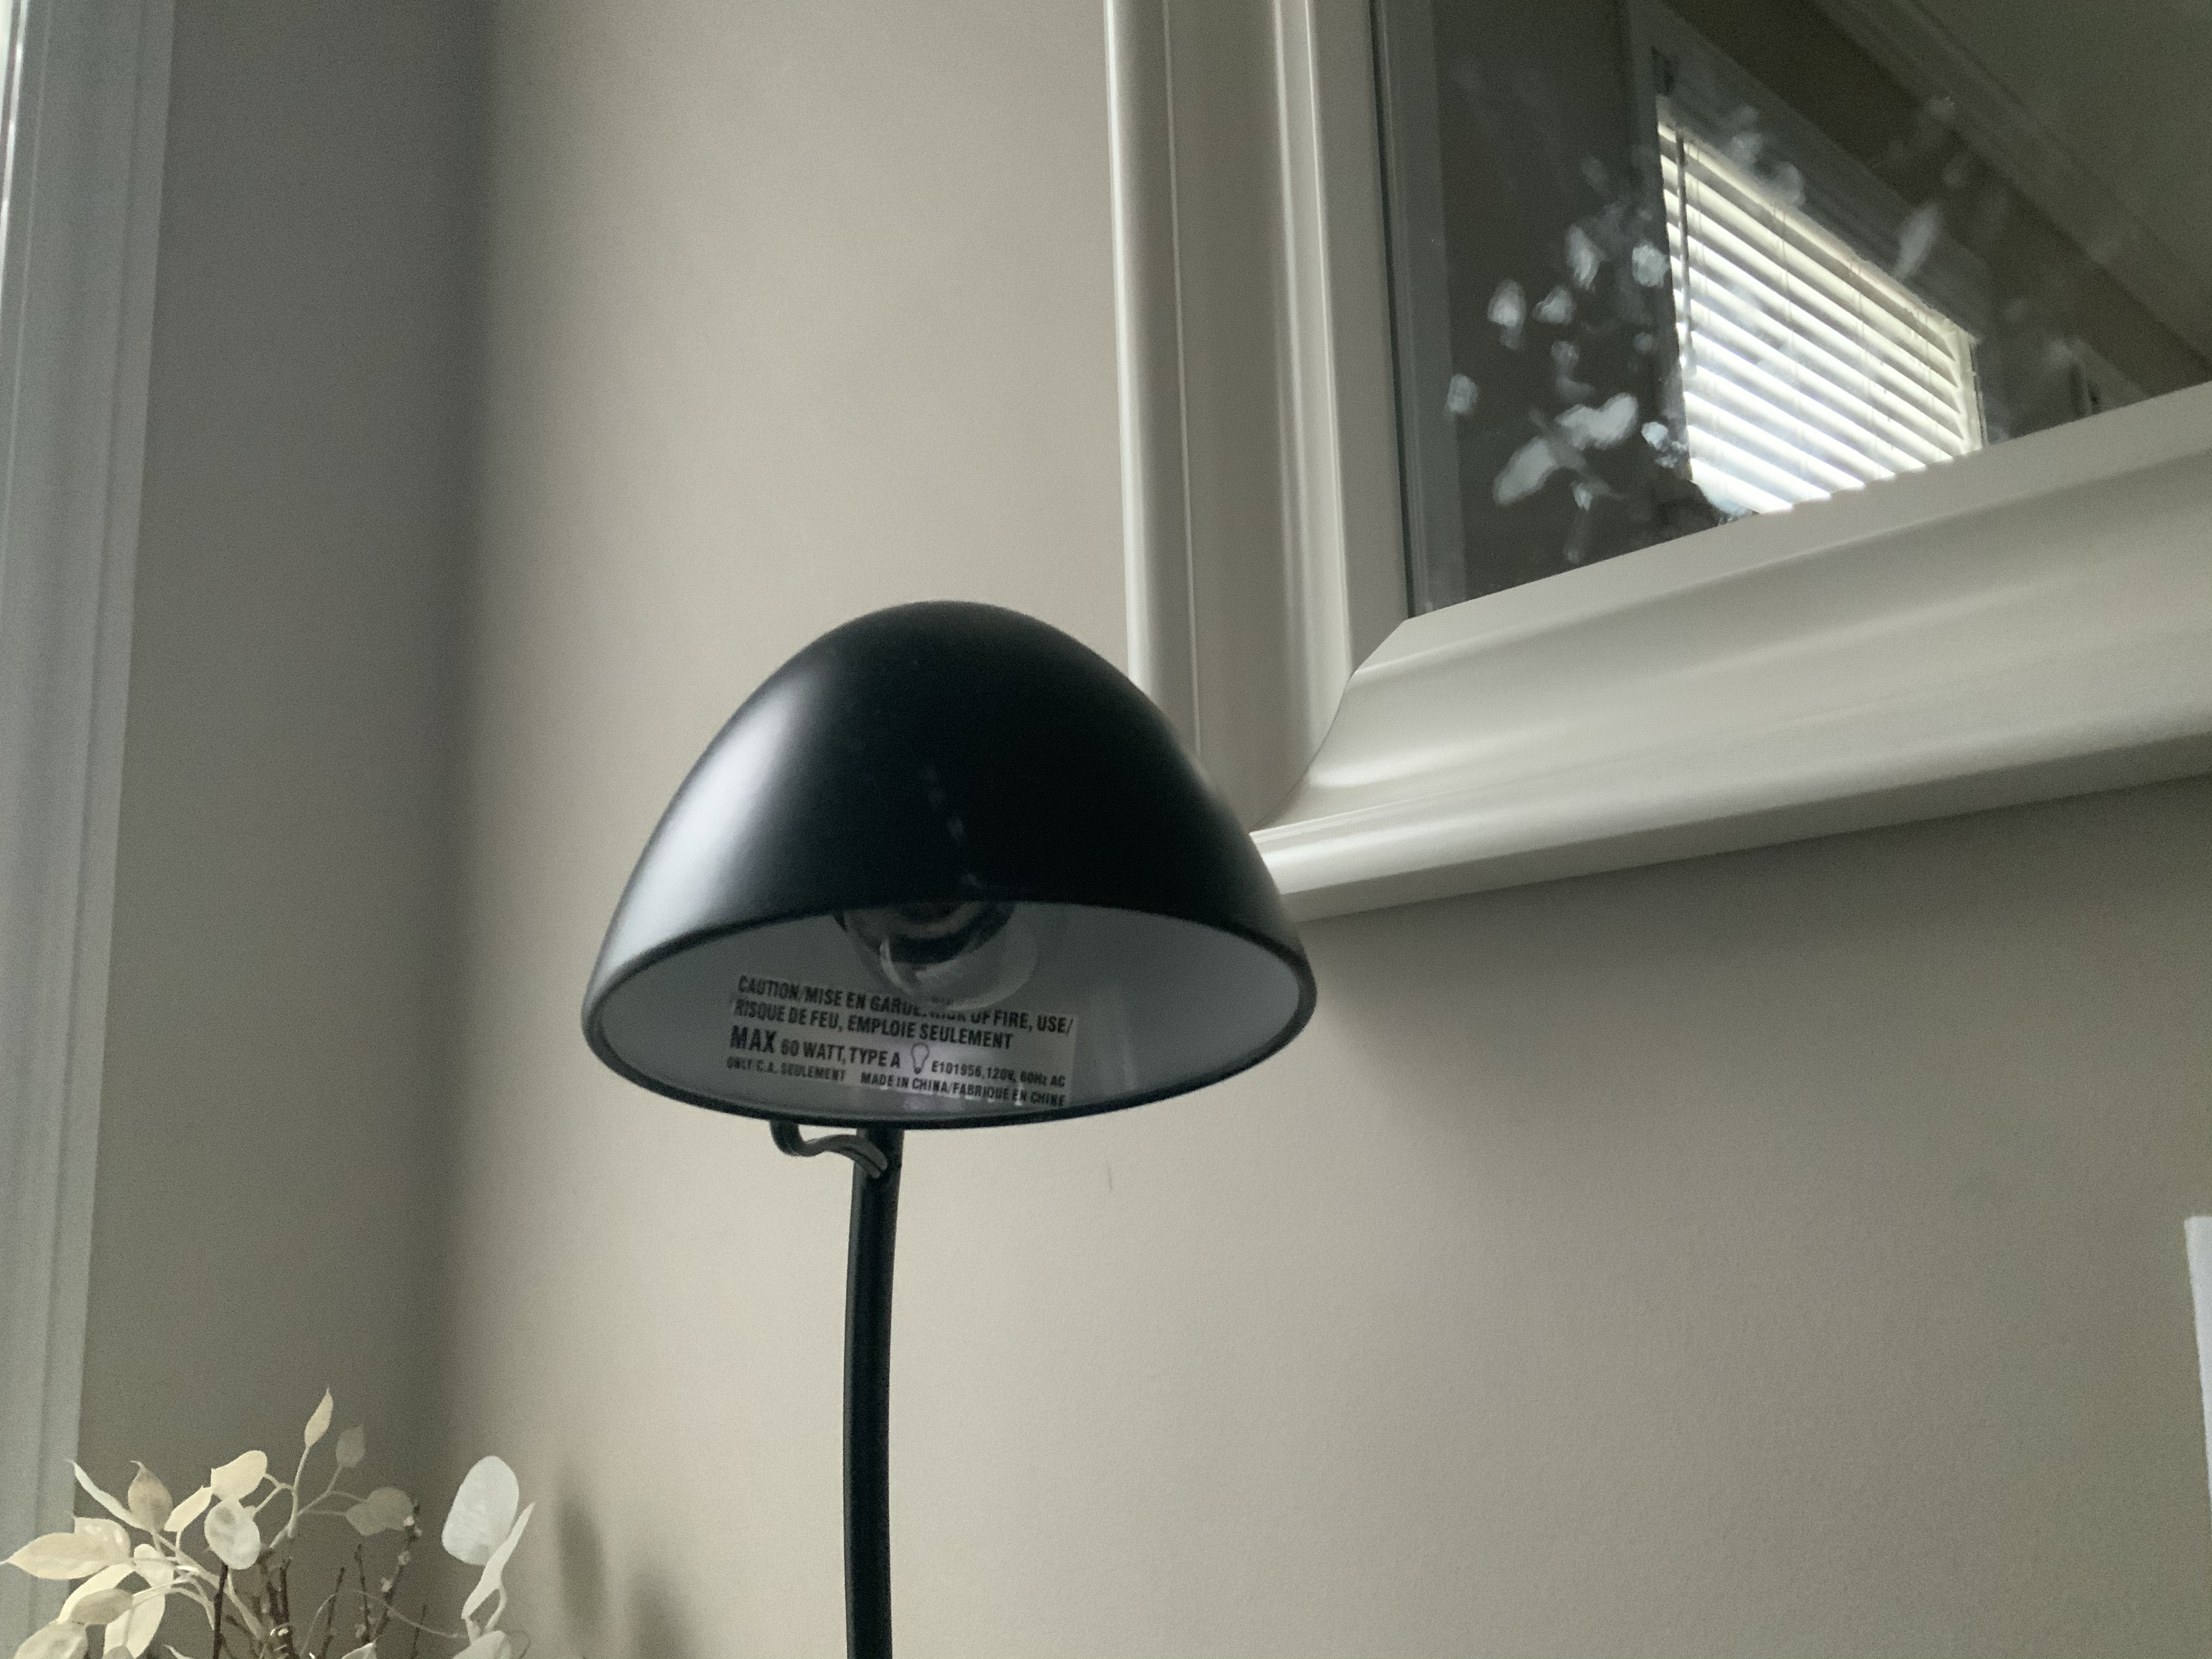
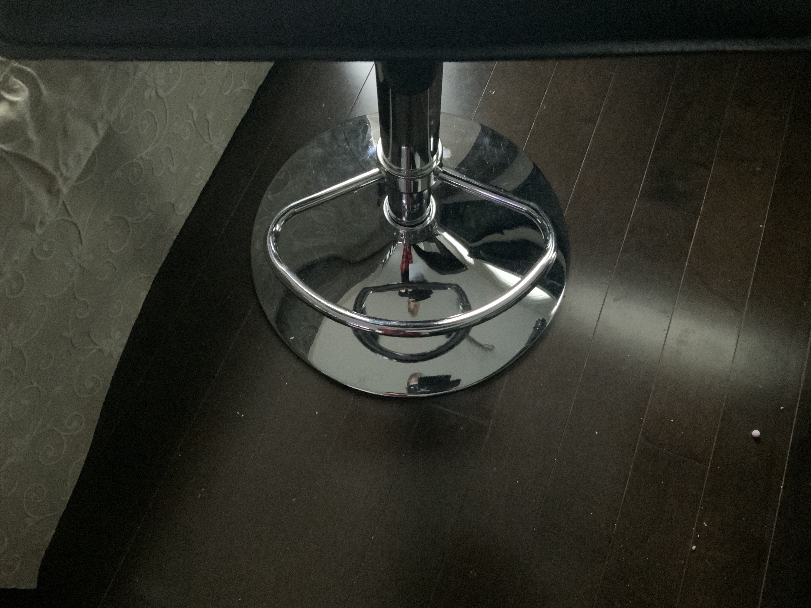
Modelling Quadratics with Pictures

Slide 20
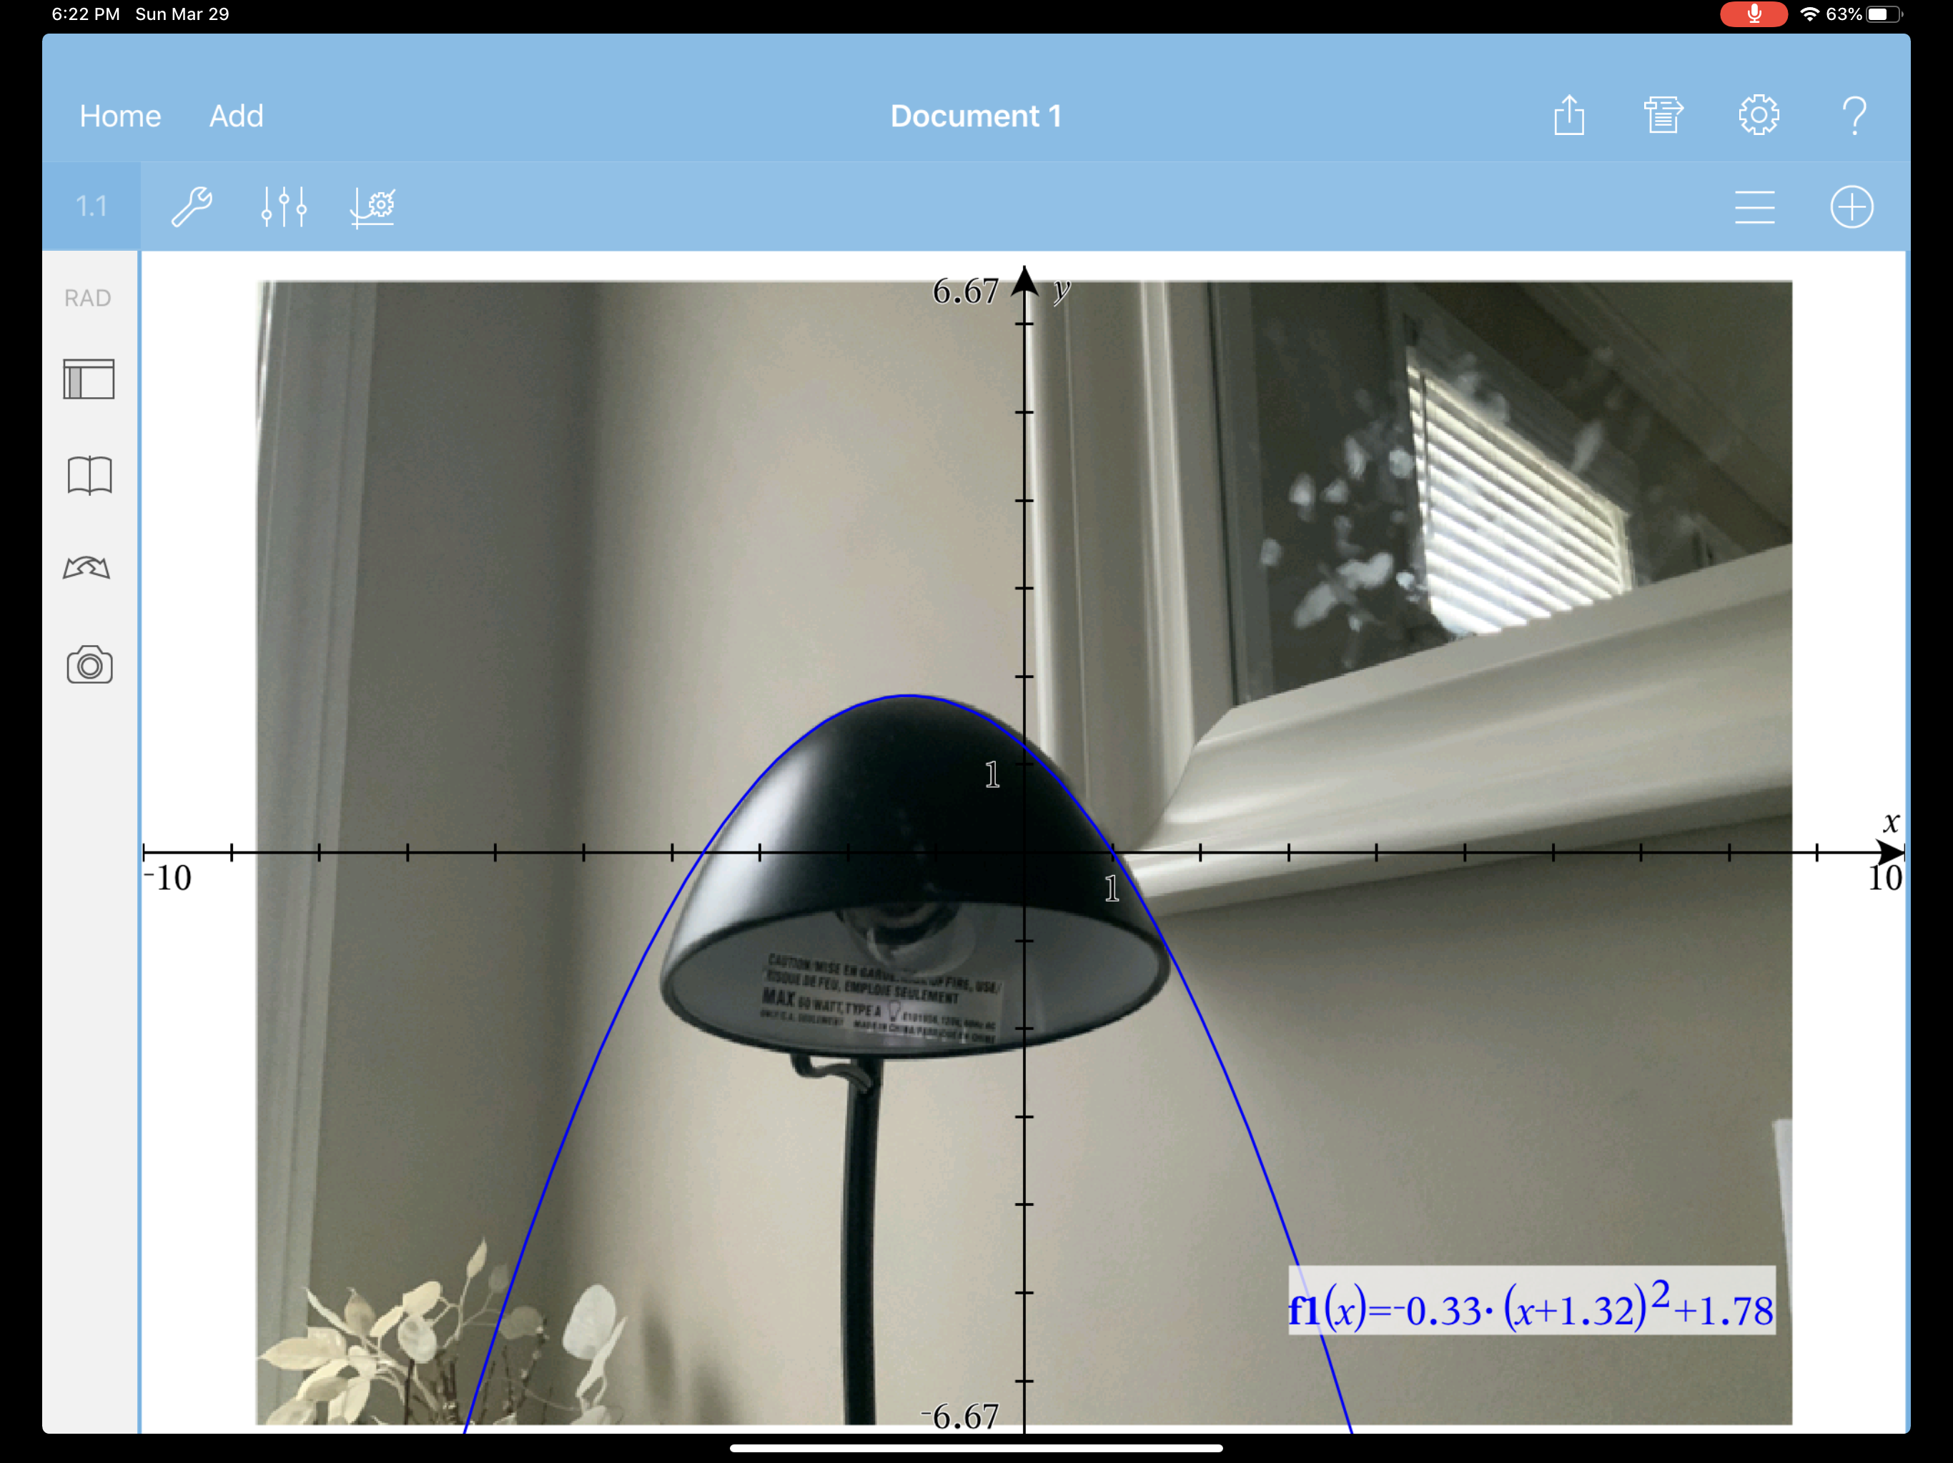
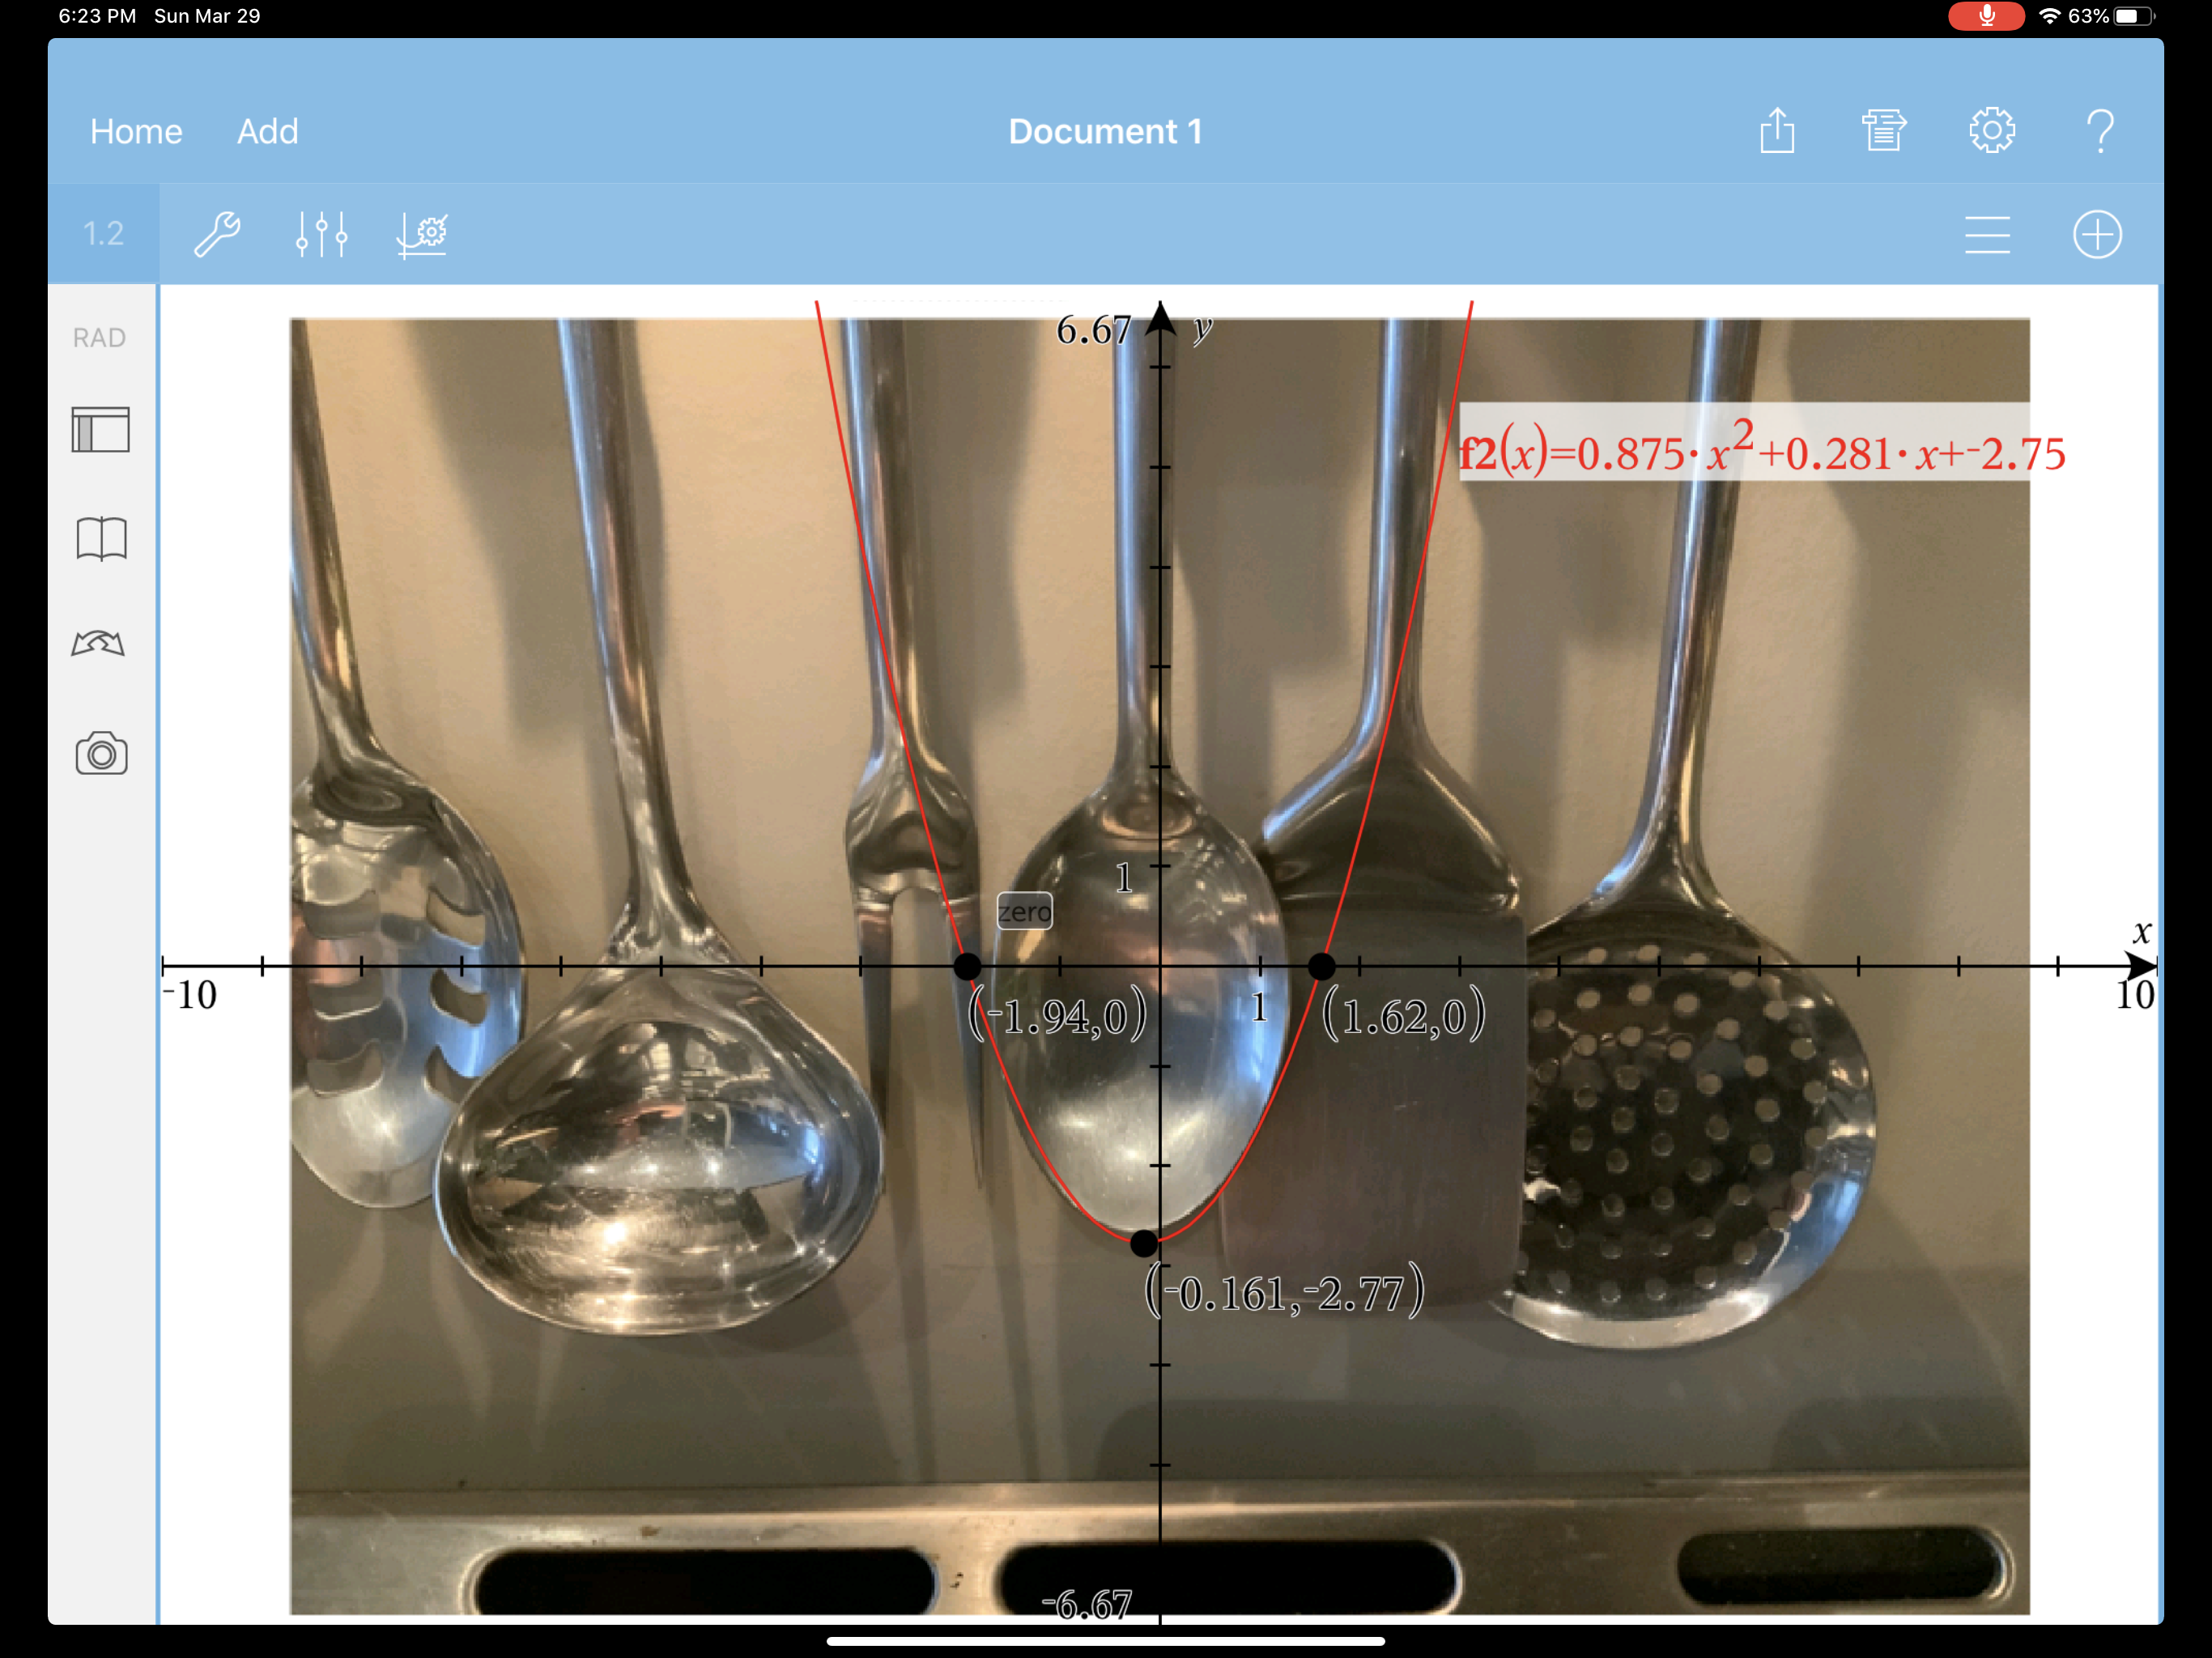
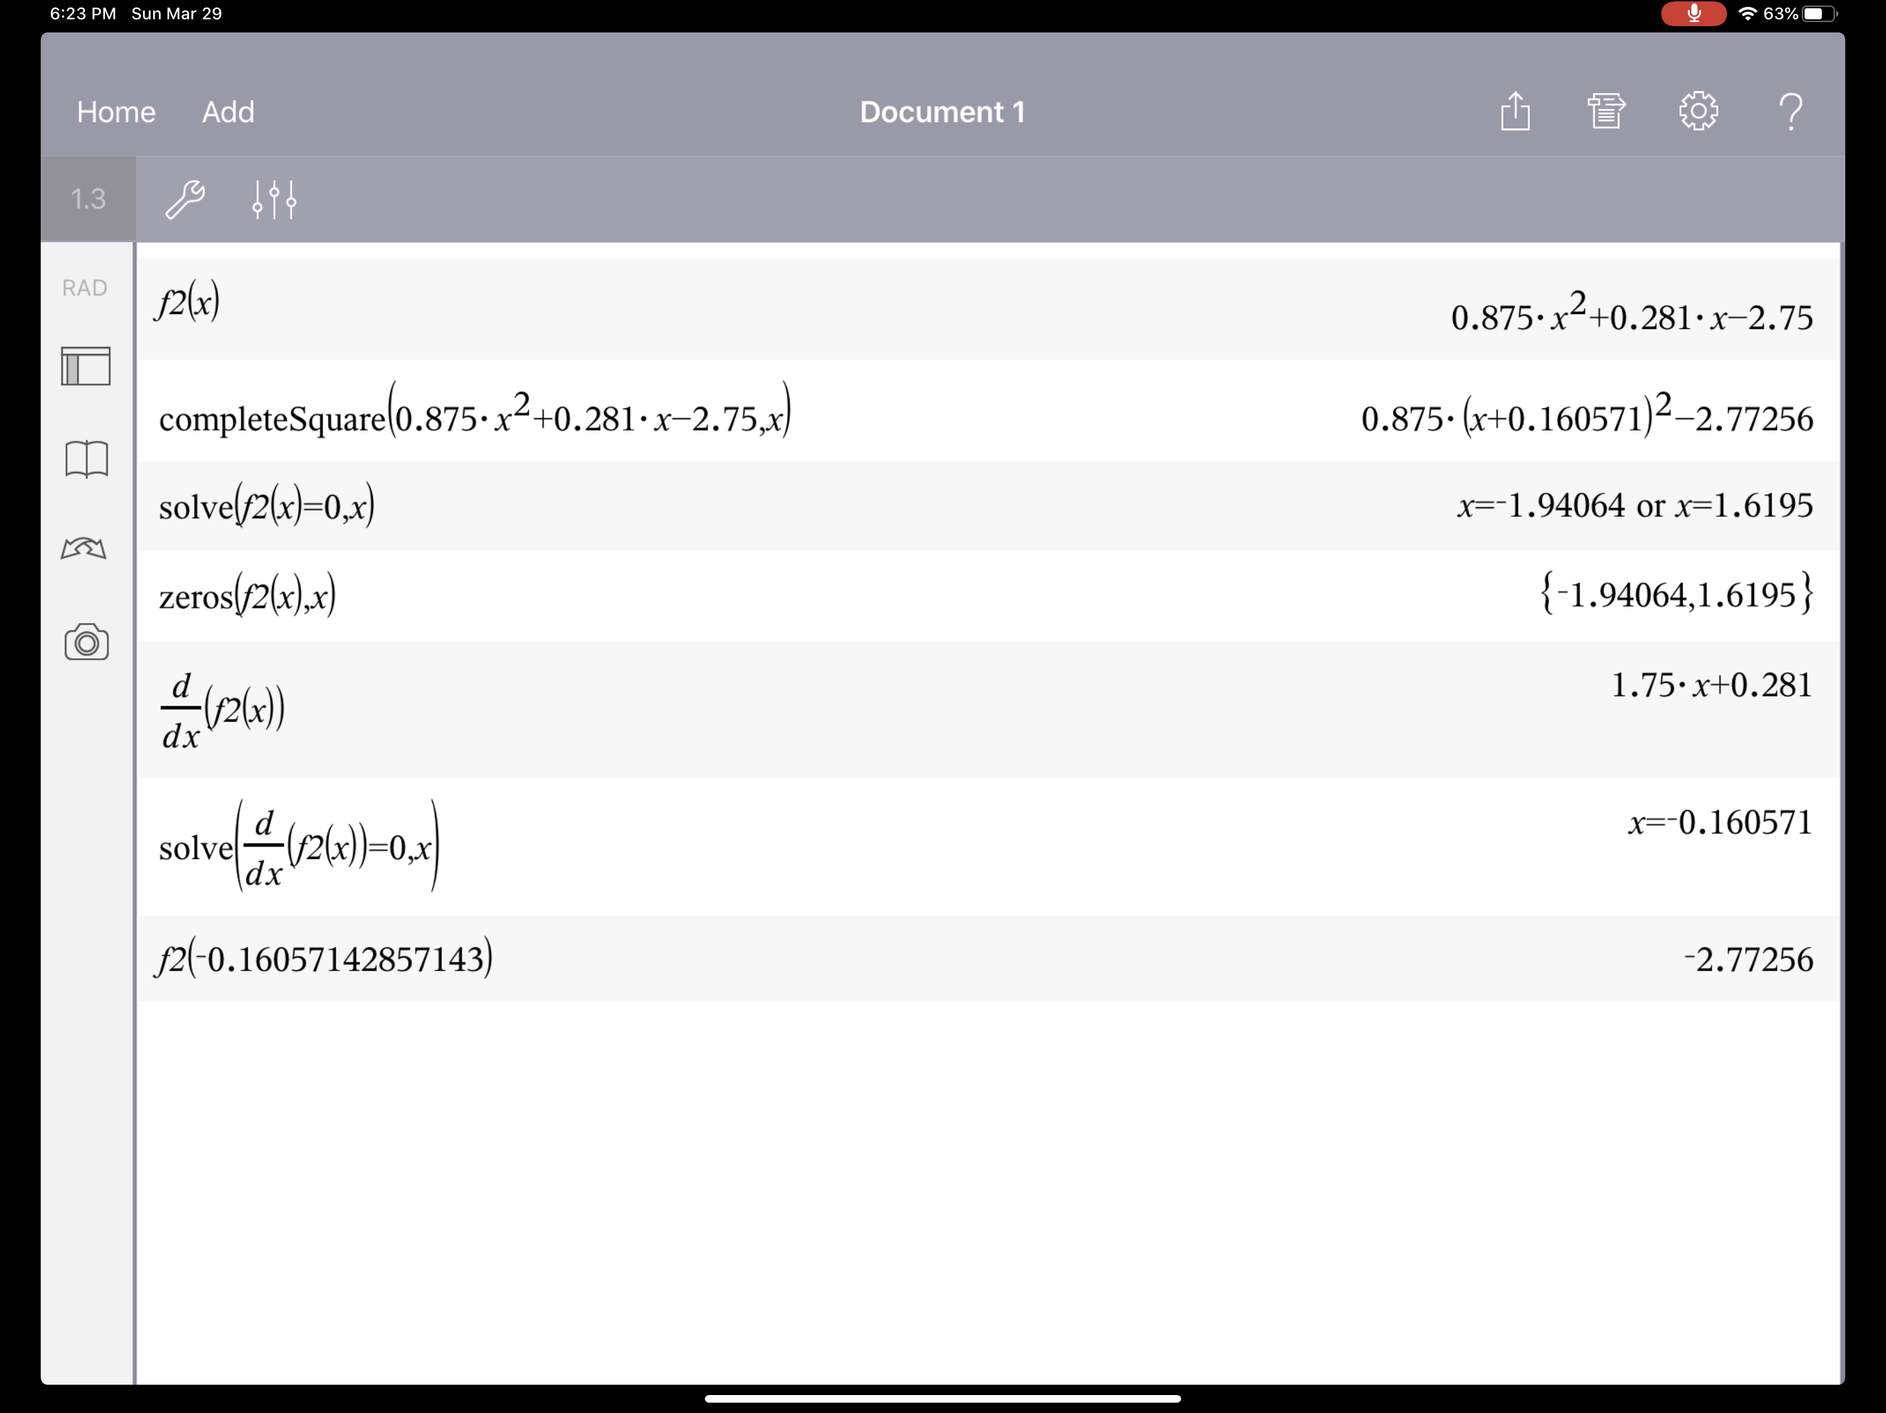
Modelling Quadratics with Pictures

Slide 21
Modelling Quadratics with Pictures

Slide 22
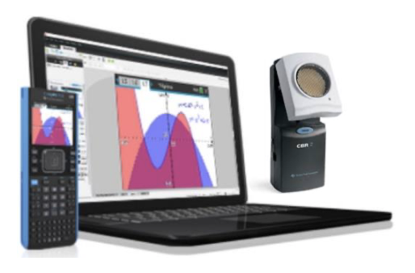
Bi-Weekly Wednesday Webinar Canadian Series
Wednesday, April 15th
Wednesday, April 29th

Slide 23
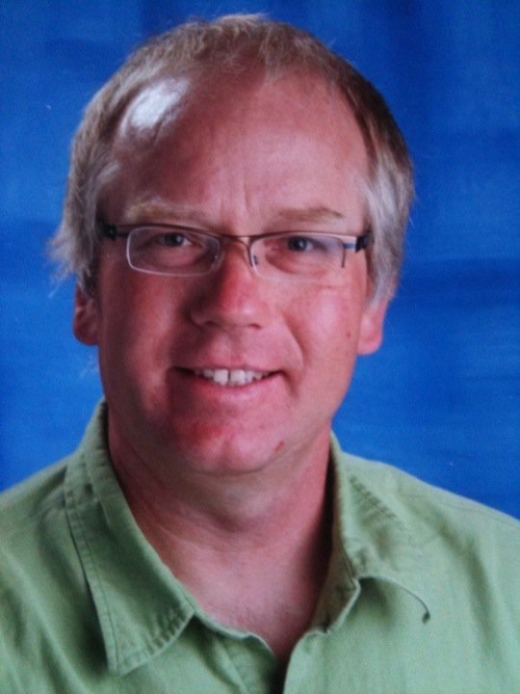
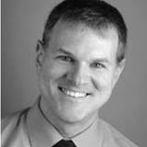
education.ti.com
Chris Atkinson
chris.atkinson@ocsb.ca
@chrisatk
Tom Steinke
tsteinke@ti.com
@tomsteinke
613-601-6535

