Slide 1
Simulating Dice With Python on the TI-Nspire™ CX II Graphing Calculator
Chris Atkinson

Slide 2
Input / Output

Slide 3
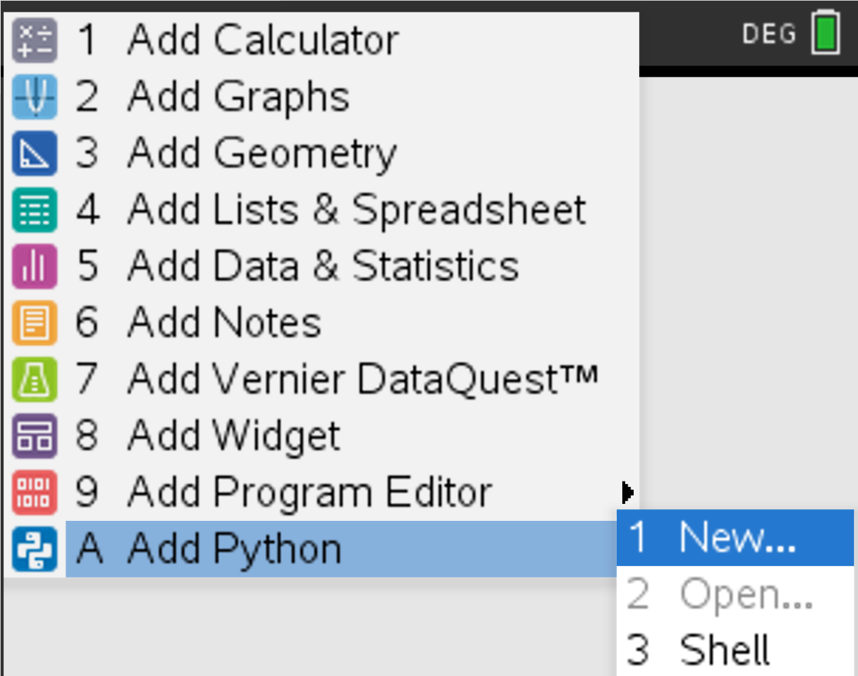
Creating Our Python Program
Home-> A Add Python -> 1 New

Slide 4
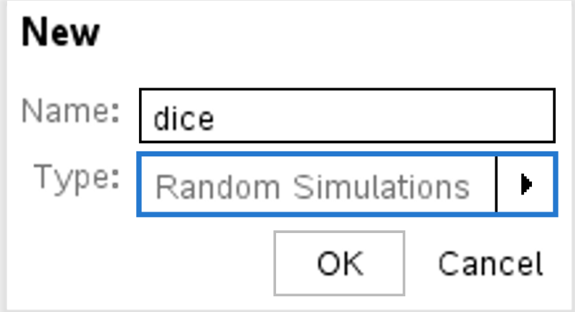
Creating Our Python Program
Give the program a name and select Random Simulations for the Type

Slide 5
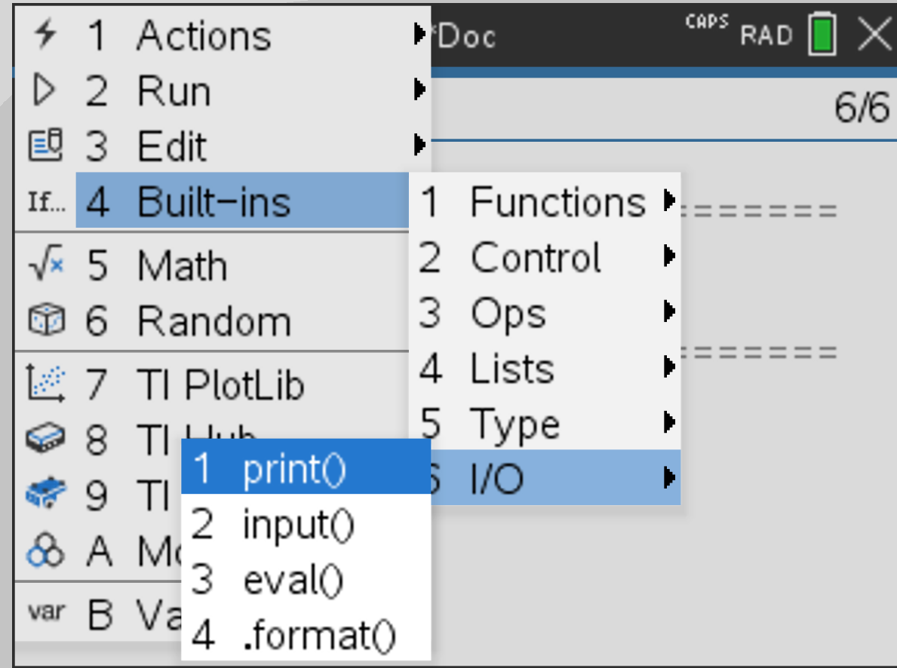
Output Something
Menu -> 4 Built-ins -> 6 I/O -> 1 print()

Slide 6
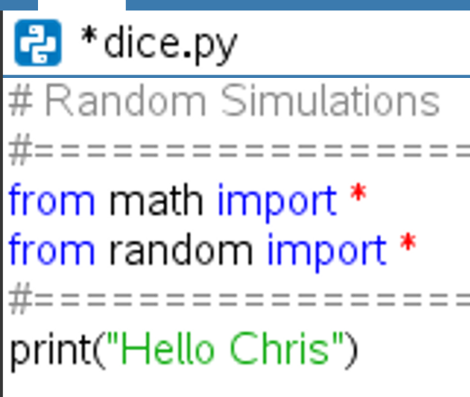
Output Something
print(“Hello #YOUR NAME#”)

Slide 7
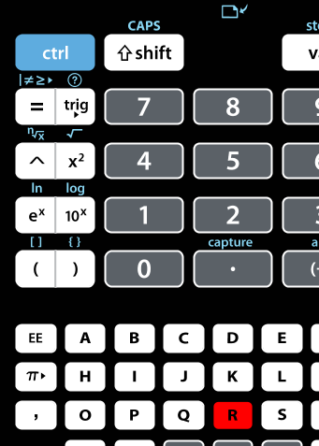
Run the code
CTRL-R

Slide 8
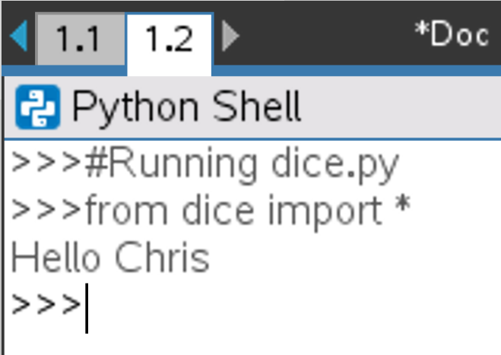
New Python Shell
You should see a new python shell appear with the result of your running code

Slide 9
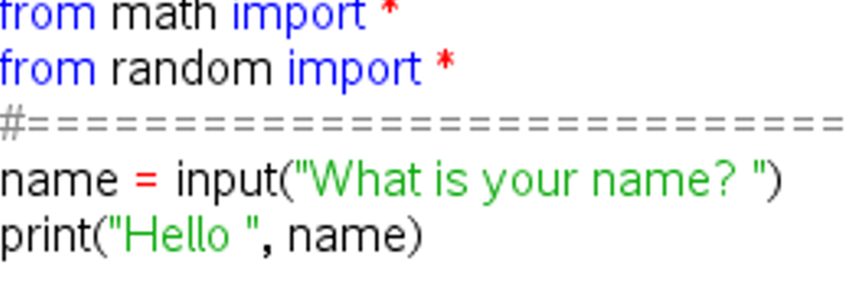
Output Something More Interesting
Collect the user’s name and welcome them
Menu -> 4 Built-ins -> 6 I/O -> 2 input()

Slide 10
Run the code
CTRL-R

Slide 11
Randomness

Slide 12
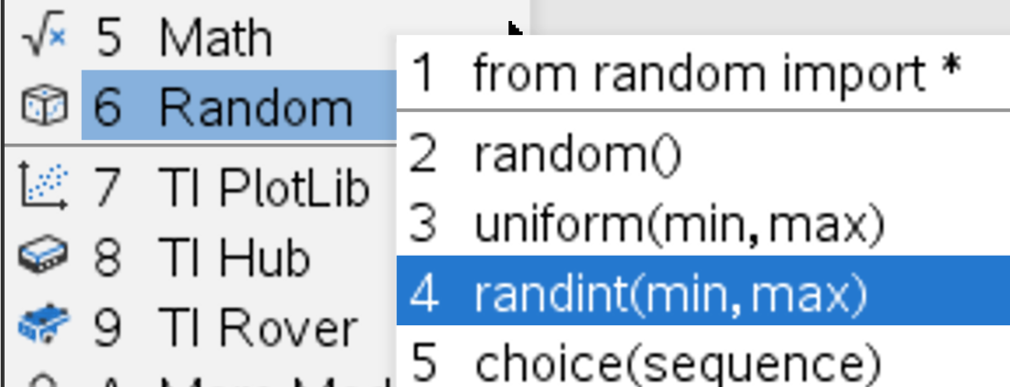
Generate a Random Number
Menu -> 6 Random -> 4 randint(min,max)
Notes:
Start on a new line below your commented out code
CTRL-T OR Menu -> Edit -> 3 Comment/Uncomment

Slide 13
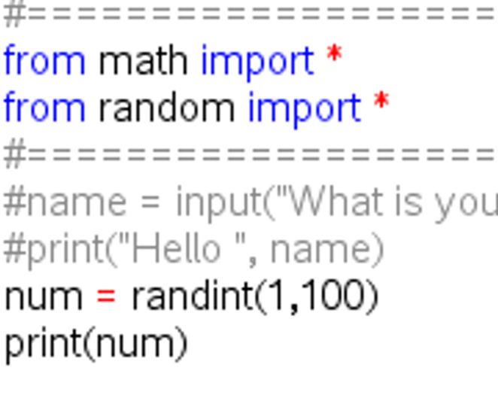
Generate a Random Number
Assign your random number between 1 and 100 to a variable and print that number

Slide 14
Run the code
CTRL-R

Slide 15
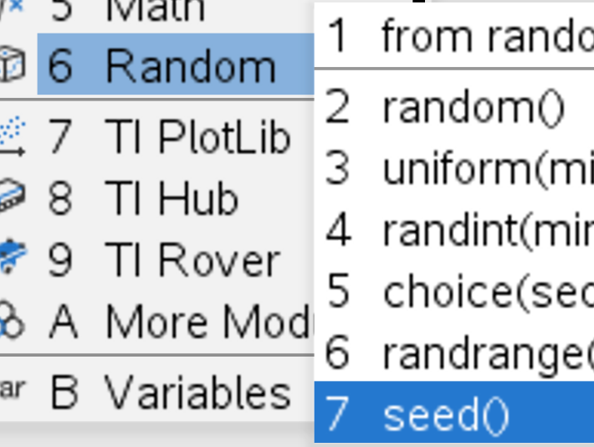
Random Seed
Menu -> 6 Random -> 7 seed()
Notes:
Insert a blank line above your random number assignment

Slide 16
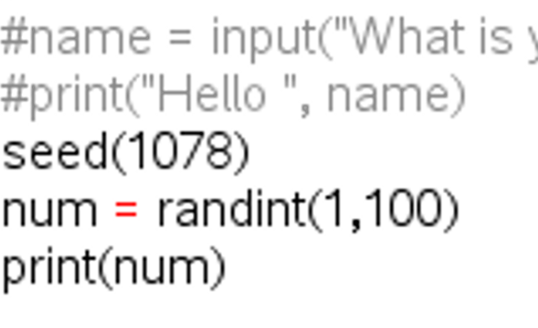
Random Seed
Use any random integer to seed your program

Slide 17
Run the code
CTRL-R

Slide 18
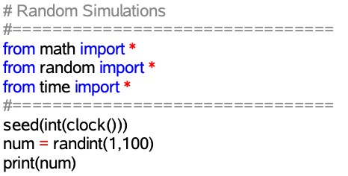
Quirks of Randomization
Repeated running of the code will yield the same results. You may need to randomize even your seed.
Notes:
If a seed isn’t randomized, then you get the same sequence of random digits with each execution of the code. Consider ways to randomize the seed value with a combination of user input and random numbers. Highlight the difference between strings and variables in the print statement and how they are different colors. Also highlight the importance of quotation marks opening and closing.

Slide 19
Run the code
CTRL-R

Slide 20
For Loops

Slide 21
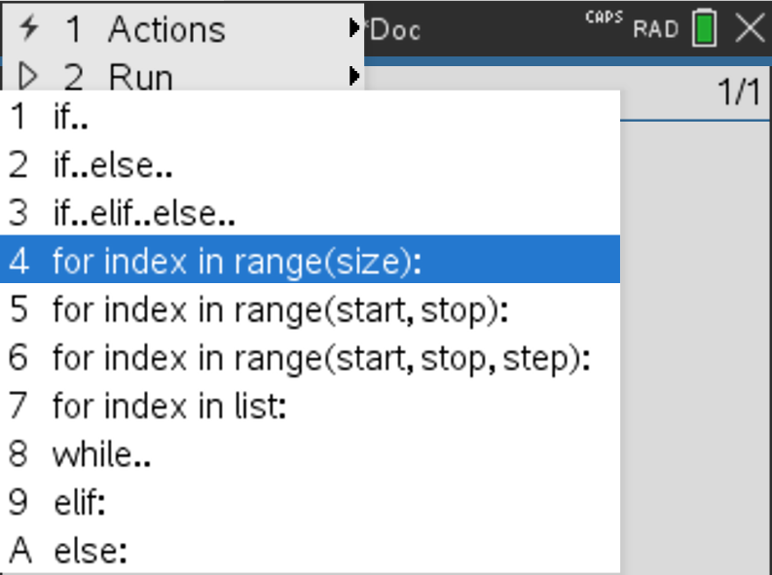
Control Structures (Loops)
Menu -> 4 Built-ins -> 2 Control -> 4 for index in range(size)

Slide 22
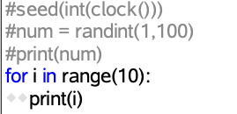
Control Structures (Loops)
Print the first 10 values

Slide 23
Run the code
CTRL-R

Slide 24
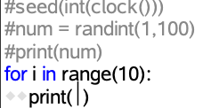
Control Structures (Loops)
Modify your code to print 1 through 10
Modify your code again to print 10 through 1

Slide 25
Control Structures (Loops)
Modify your code to print 10 random numbers
Modify your code again to ask the user how many random numbers they want

Slide 26
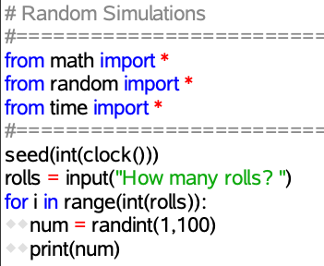
Control Structures (Loops)
Possible Solution
Notes:
Introduce the code to roll the dice inside of a for loop. Highlight the importance of tabbing the code over two spaces that will be run inside the loop.
NOTE: THIS CODE WILL FAIL. Input is received as a string and needs to be cast to an integer. We will do that in the next slide.

Slide 27
Die Rolls

Slide 28
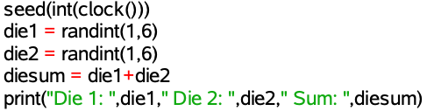
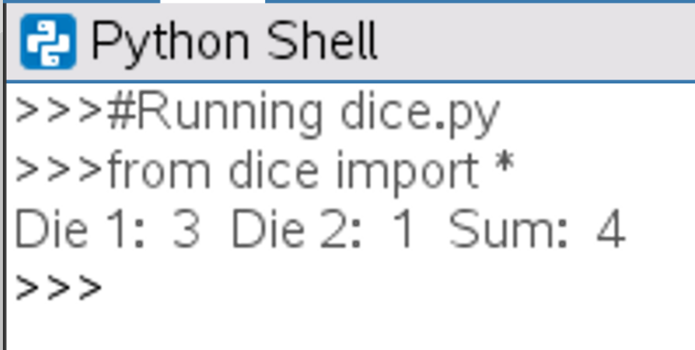
Roll Two Die
Menu -> 6 Random -> 4 randint(min,max)
Store results in variables die1, die2 and the sum in diesum
Notes:
Stop to give students a chance to produce the desired output in the shell pictured on this slide. There are multiple ways of getting here, but one example is shown above

Slide 29
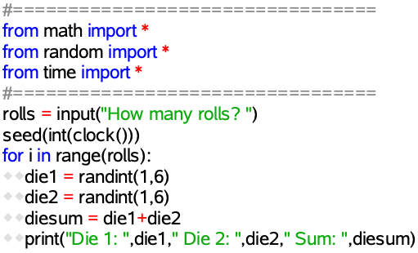
Repeated Rolls of a Die
Use what you learned about For Loops to roll the die 10 times
Use what you learned about User Input to roll the die x times
Notes:
Introduce the code to roll the dice inside of a for loop. Highlight the importance of tabbing the code over two spaces that will be run inside the loop.
NOTE: THIS CODE WILL FAIL. Input is received as a string and needs to be cast to an integer. We will do that in the next slide.

Slide 30
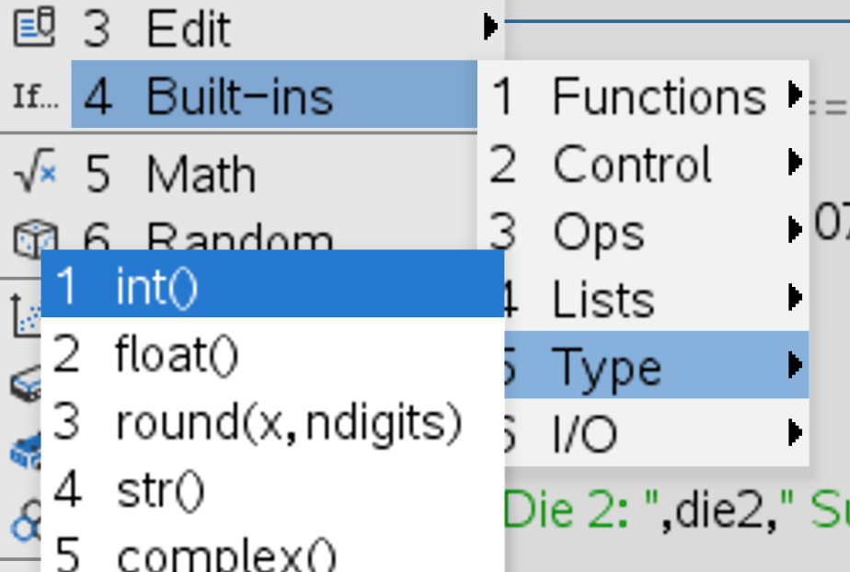
Type Casting
Basically...make user input a number
Menu -> 4 Built-ins -> 5 Type -> int()

Slide 31
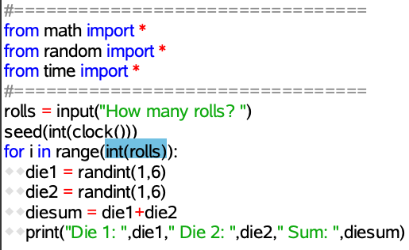
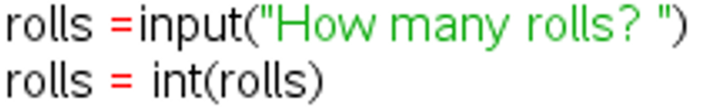

Type Casting
Basically...make user input a number
Notes:
Make sure everyone is caught up at this point.

Slide 32
Store Lists

Slide 33

Collect the Data
Start with an Empty List/Array
Menu -> 4 Built-ins -> 4 Lists -> 1 []
Notes:
Insert new blank line just before the for loop to create your new empty list on.

Slide 34
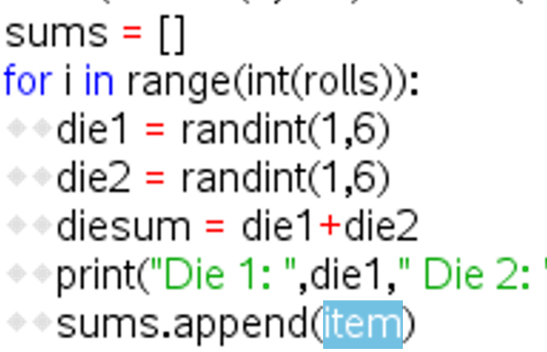
Collect the Data
Add to the list with each Die Roll
Menu -> 4 Built-ins -> 4 Lists -> 6 .append()
Notes:
Insert new line inside for loop at the end of the loop to append the data to the list

Slide 35
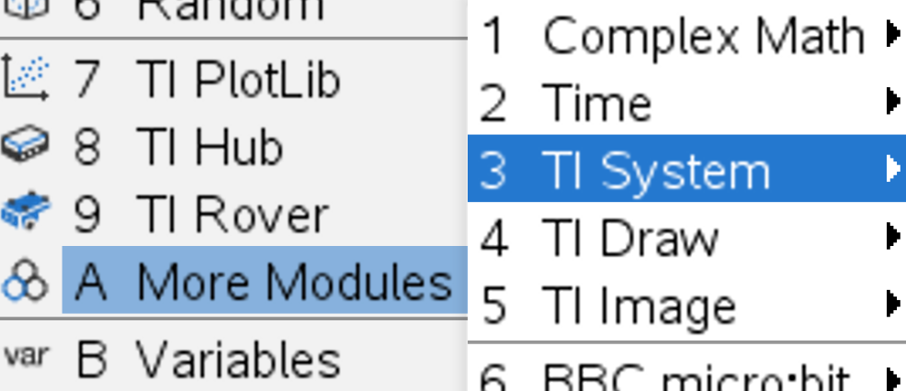
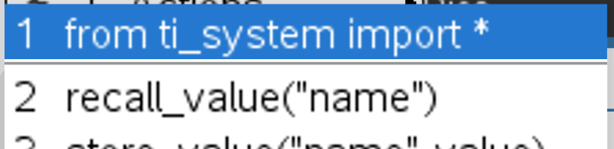
Share the Data
Store/Save/Share the data
Menu -> A More Modules
-> 3 TI System
-> 1 from ti_system import *
Notes:
Insert a new blank line after the first two import statements for this third import statement.

Slide 36
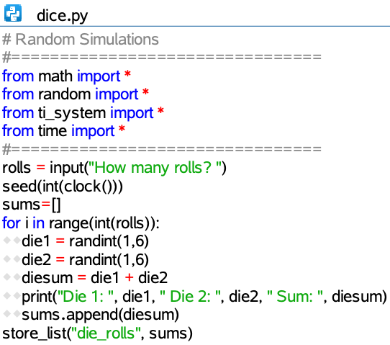
Share the Data
Store/Save/Share the data
Menu -> A More Modules
-> 3 TI System -> 5 store_list(“name”,list)

Slide 37
Run the code
CTRL-R

Slide 38
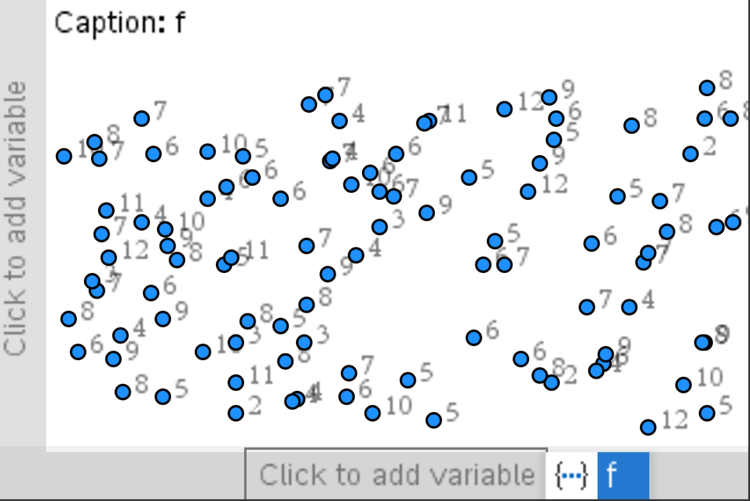

Analyze the Results
Home -> ->Data and Statistics

Slide 39
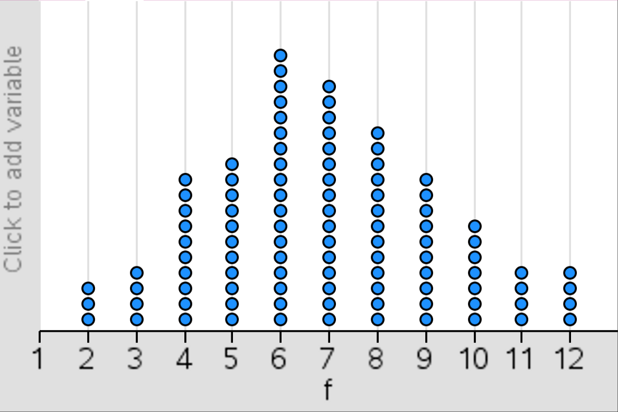
Analyze the Results
Home -> ->Data and Statistics

Slide 40
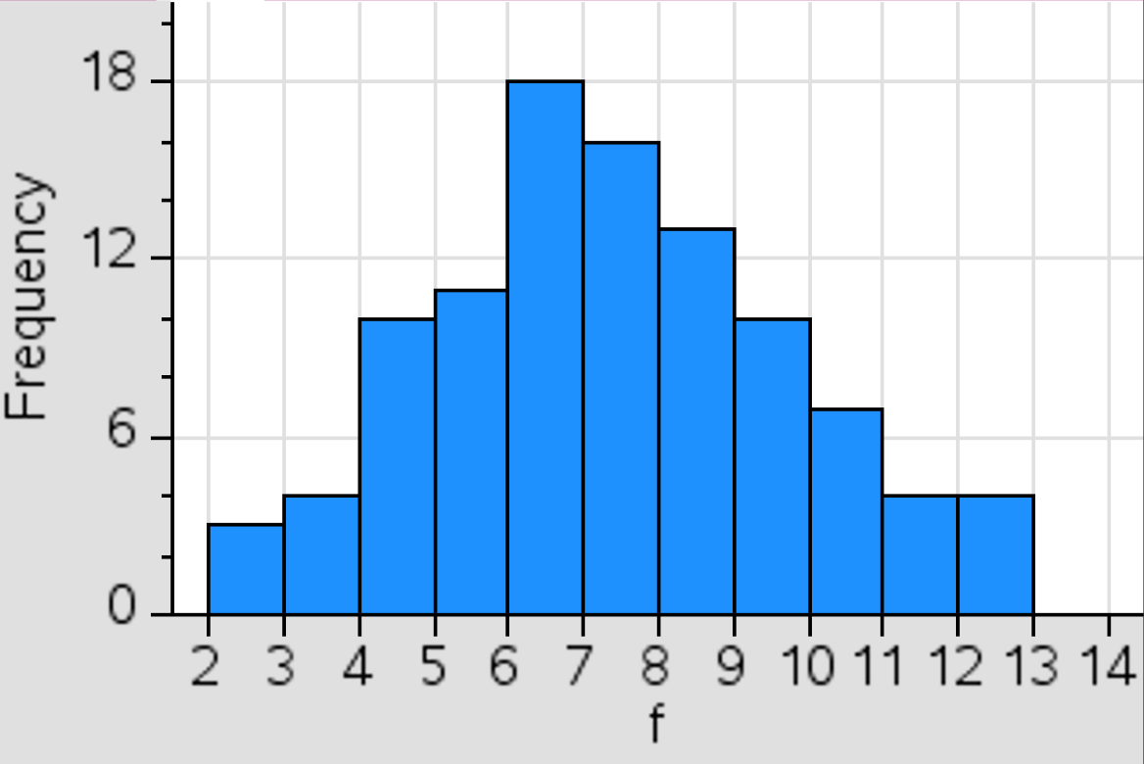
Analyze the Results
Menu -> 1 Plot Type -> 3 Histogram

Slide 41
Next Steps

Slide 42
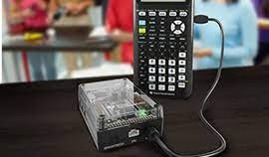
What Next?
Sound or light on die roll
Light sensor triggers die roll with Innovator Hub

Slide 43
Simulating Dice With Python on the TI-Nspire™ CX II Graphing Calculator
Chris Atkinson

Slide 44
Thank You
Chris Atkinson

Slide 45


